Slide 1
GST BILLING APP

Slide 2
Team
Bandhan Kalkani – 20SOEIT11010
Dhaval Harkhani – 20SOECE11019
Jenil Donga – 20SOEIT11007

Slide 3
Need of application
Purpose of this application is to make gst bill. We can make gst bill with all gst rate.
It allows business owners to easily and accurately manage various aspects of GST billing like invoicing, inventory management.
It also helps with account administration and tax calculations.

Slide 4
Scope of the project
Scope of this project is to investigate and design a software solution which can facilitate both customer and salesperson in performing.
Billing management/software accessible anywhere With access to the data from everywhere and anywhere, it is quite an advantage to have cloud inventory management/software as it will provide every access to the stock data.

Slide 5



technology
User specification
Ram & rom specification
In this application there is only one user. he/she can make gst bill.
he/she add customer in this application. user can make pdf file easily in this application.
user directly can call to customer.
Software specification
Hardware requirements:
Android mobile : version 4.4 or
Higher
RAM : 512 MB or higher
Software requirements :
IDE tools : android studio
Firebase
User interface : XML
IDE tools : android studio
Firebase
User interface : XML

Slide 6
Limitation
This app is helpful only to make GST bill.
We are not use real time data base .

Slide 7
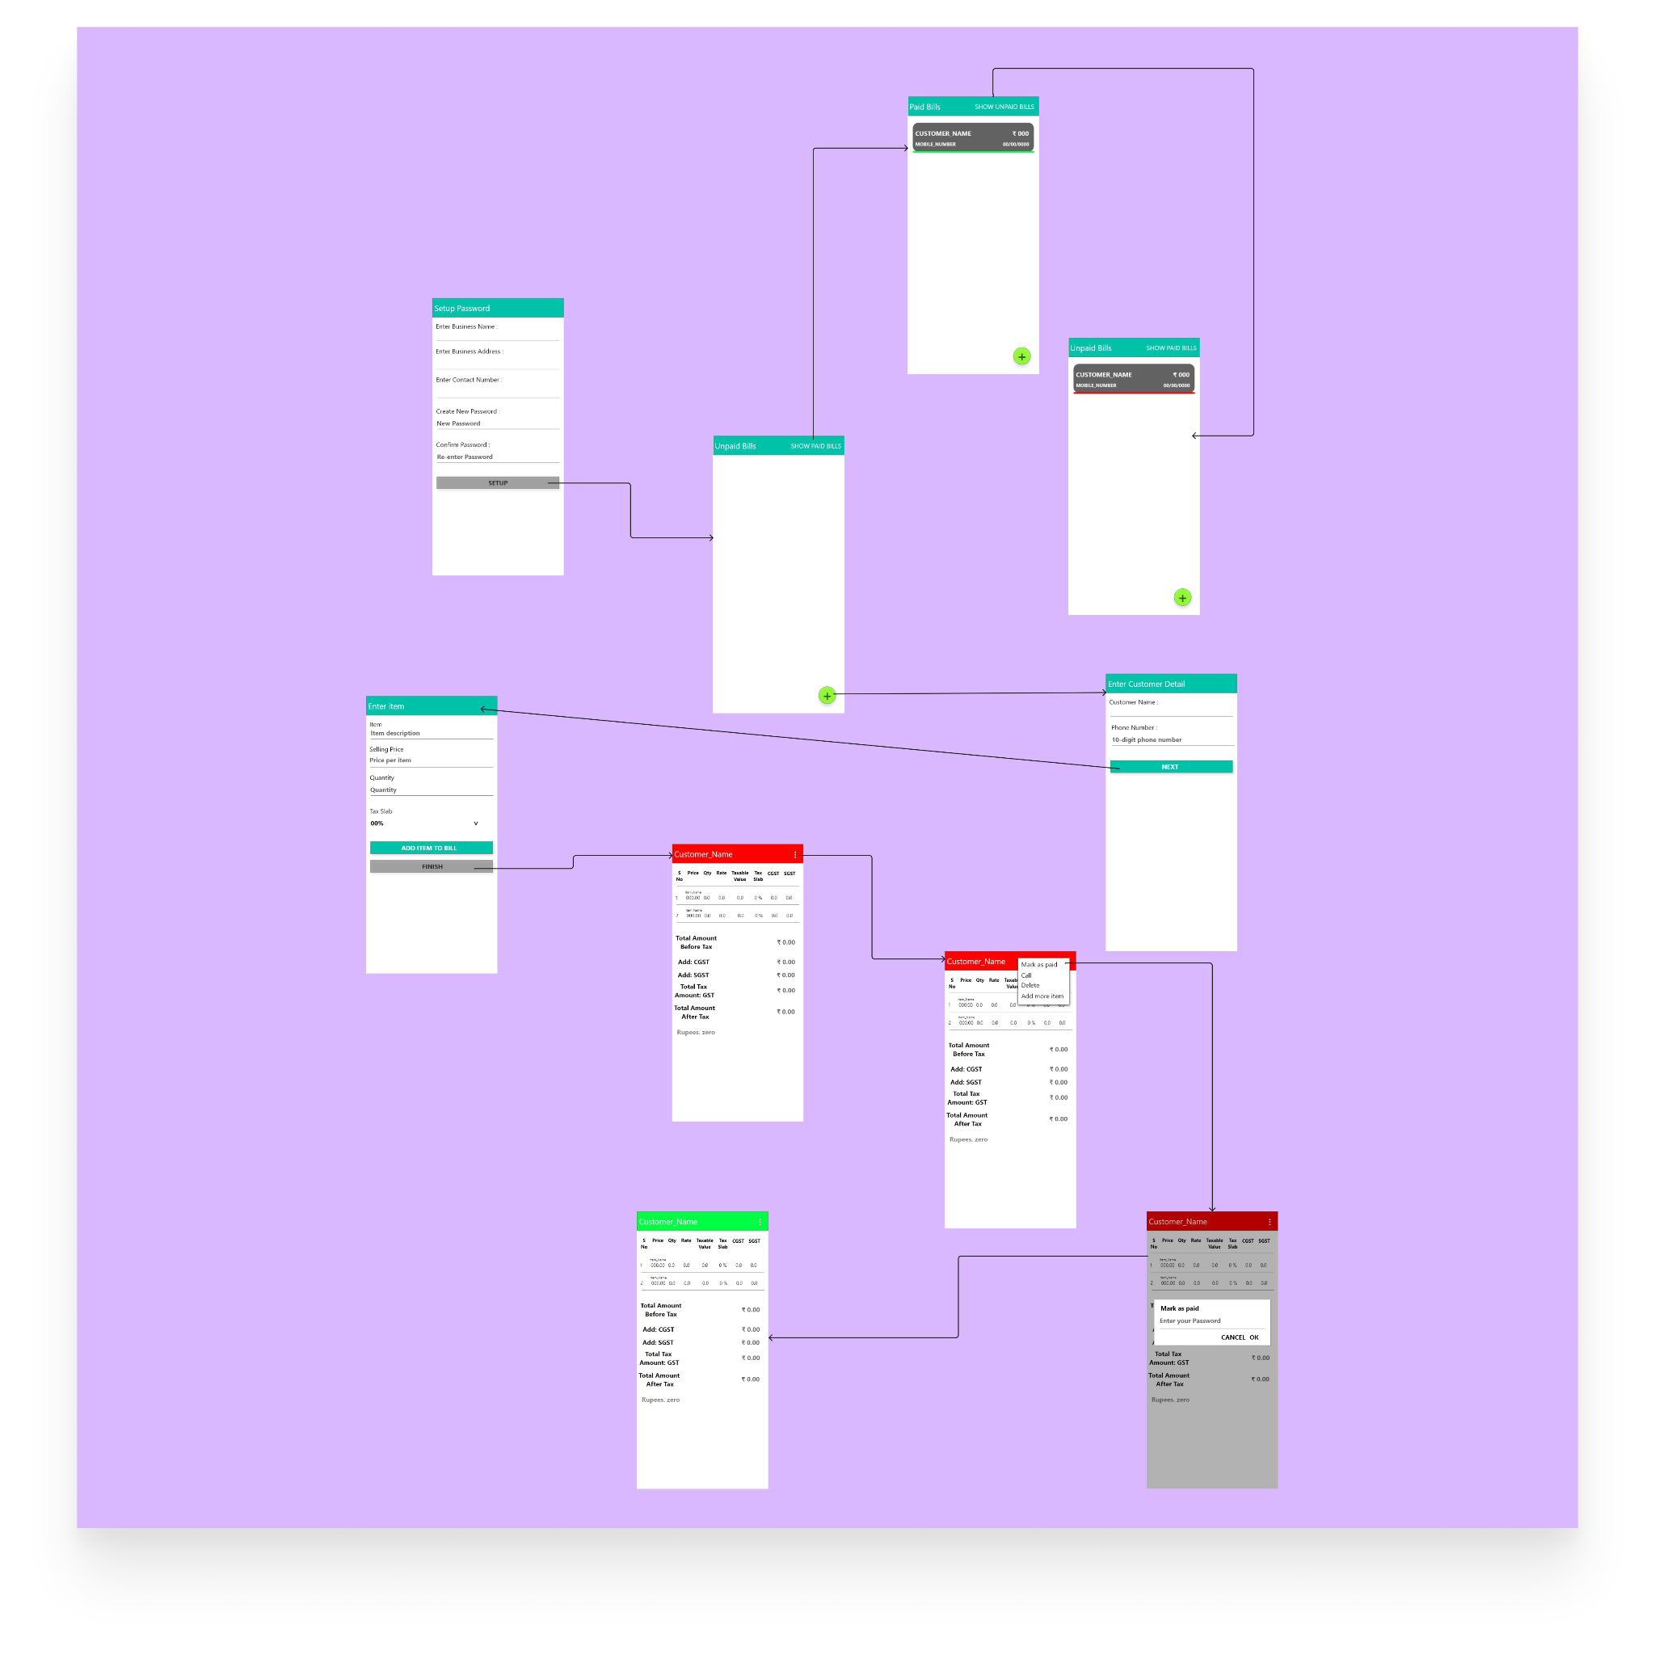
wireframe

Slide 8
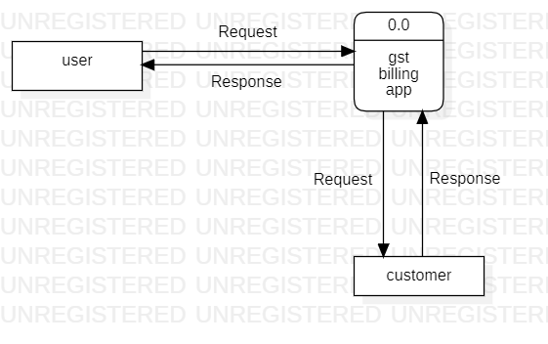
0 level DFD diagam
.

Slide 9
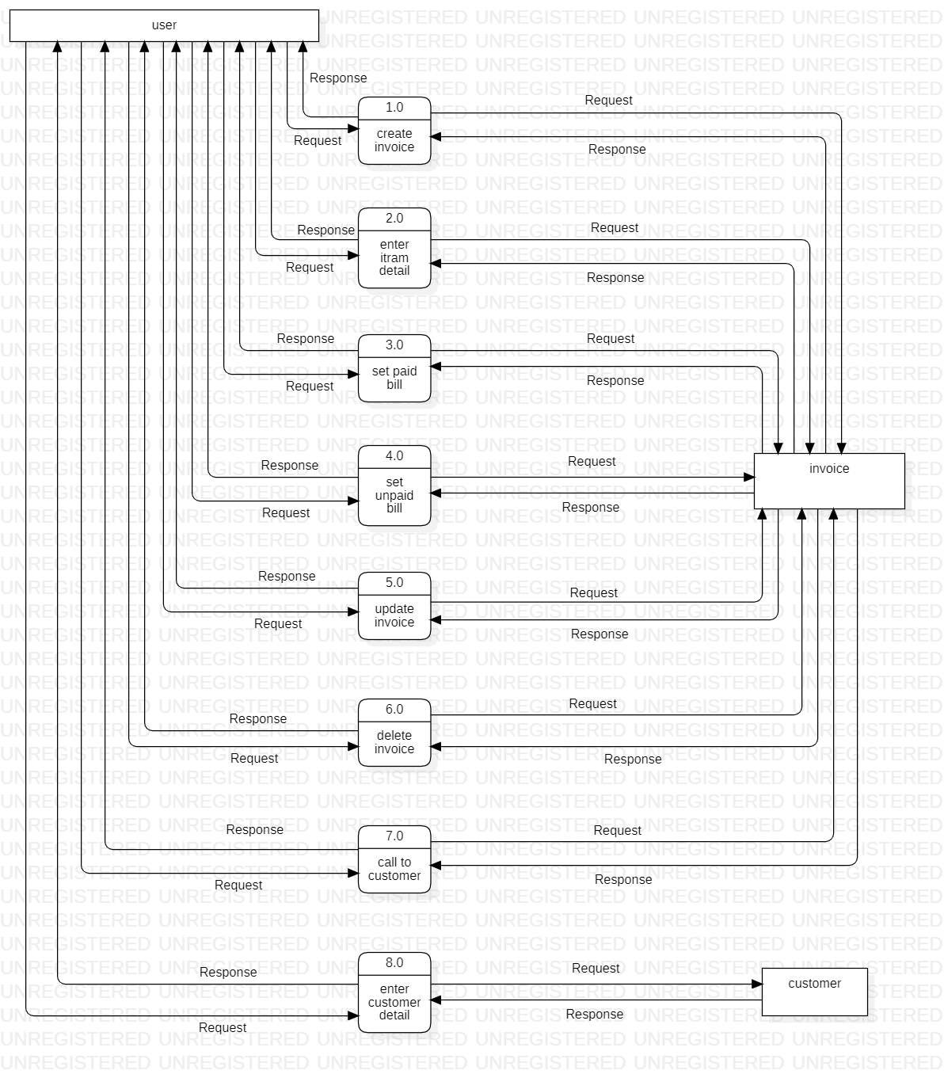
1 level DFD diagram

Slide 10
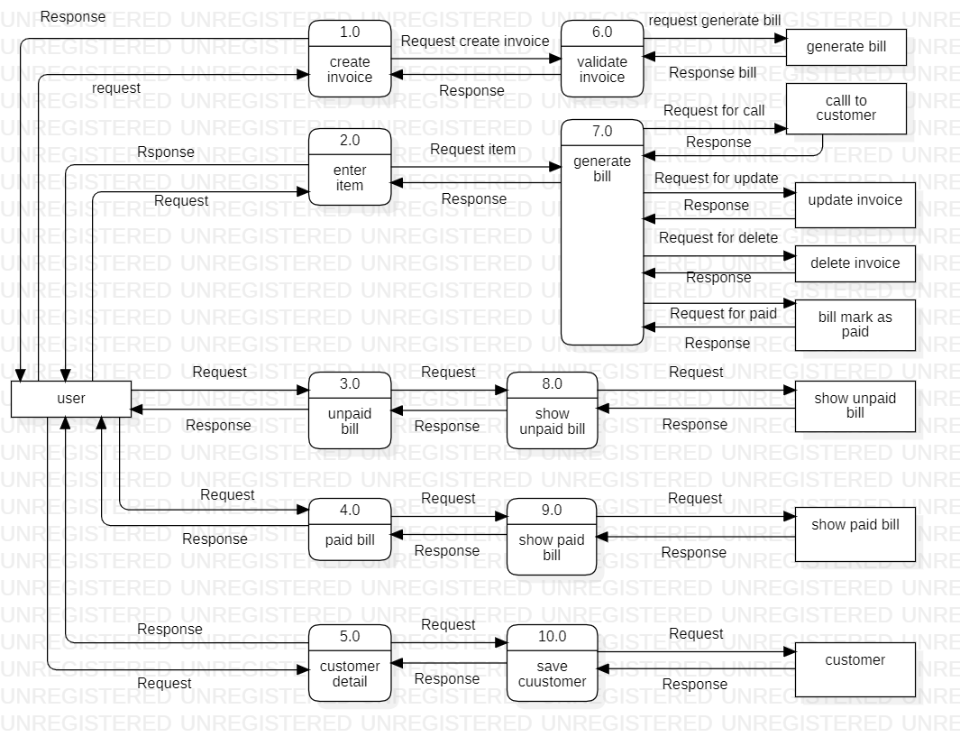
level 2 DFD diagram

Slide 11
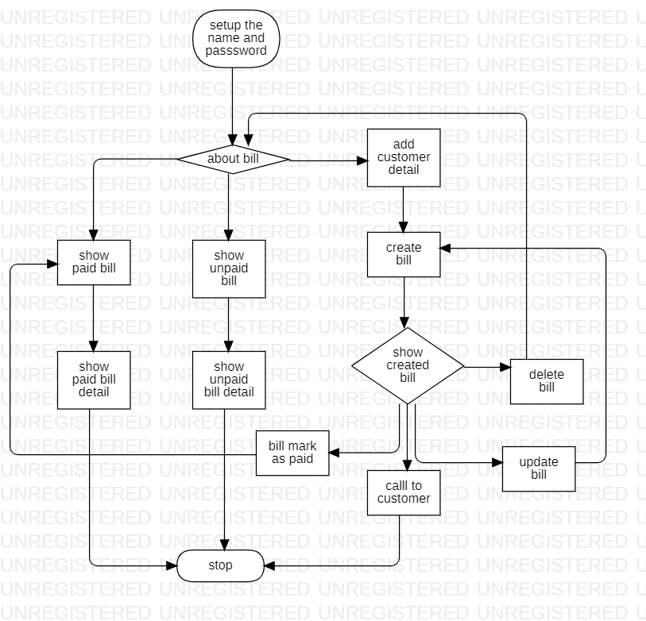
Flowchart diagram

Slide 12
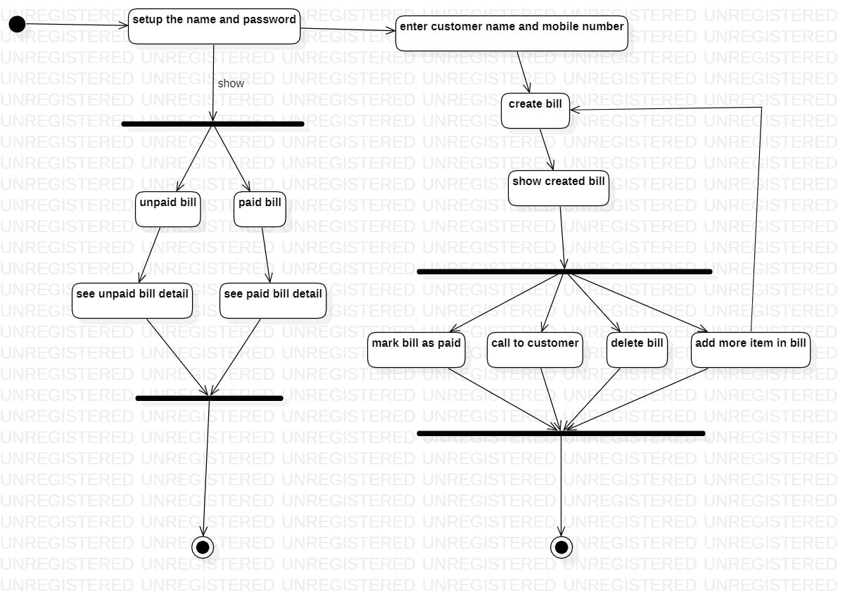
Activity diagram

Slide 13
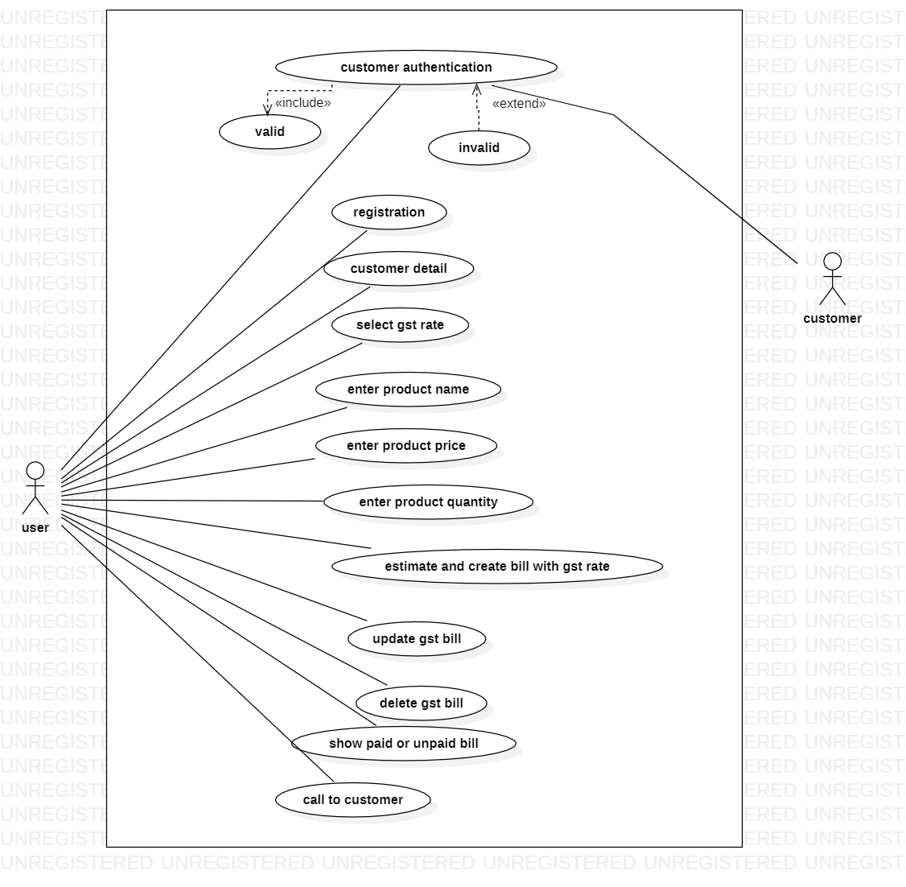
Use case diagram

Slide 14

THANK YOU

